Slide 1

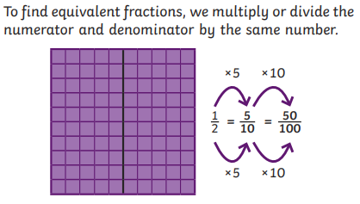

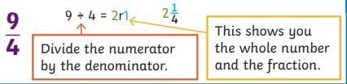
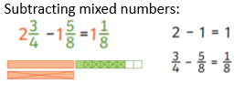

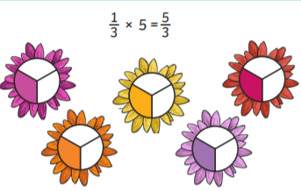
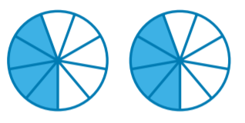

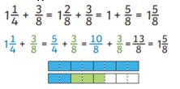
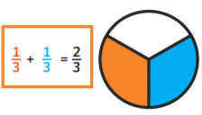
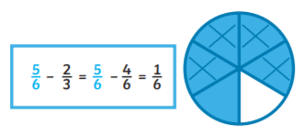
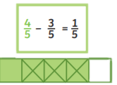
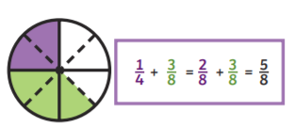

Year 5: Fractions
Sticky Knowledge
An improper fraction has a numerator which is greater than or equal to the denominator. | In order to add fractions, they must first have the same denominators. We sometimes need to find a common denominator in order to add.
Mixed numbers contain a whole number and a fraction.
Equivalent Fractions:
Vocabulary
Equivalent
Numerator
Denominator
Unit fraction
Non-unit fraction
Mixed number
Whole
Multiple
Simplest form
Converting an improper fraction to a mixed number:
Luke 6: 46-49
Matthew 25: 31-45
Subtracting mixed numbers:
Multiplying unit fractions:
Multiplying non-unit fractions:
Adding mixed numbers:
Adding and subtracting fractions:
Converting a mixed number to an improper fraction:

